Slide 1
Brain Port Vision Technology
Presented by:
Rajesh Padmanabhuni
SAP ID : 51897572

Slide 2
Topics Discussed
Statistics on the Blind
What is Brain Port Device?
Why only tongue ?
Parts of Device
Working of Device
Advantages & Disadvantages
Applications
Conclusion

Slide 3

Statistics on the Blind
37 million people in the world are blind
Every 5 seconds. One person in our world goes blind
75 million people will be blind by 2020

Slide 4
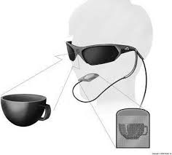
What is Brain Port Device?
Technology developed in US, that allows the blind to ‘see’ using their tongue has been developed by neuro scientists

Slide 5
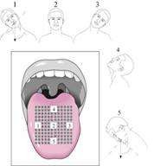
Why only tongue ?
More sensitive
Ideal place to provide information through tactile stimulation
Absence of stratum corneum
Constant moisture - Constant electric conductivity.

Slide 6
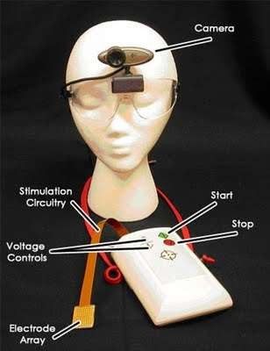
Structure of BrainPort vision device
Digital Video Camera
Brain Port Balance
Simulation circuitry
Accelerometer
Electrode Array

Slide 7
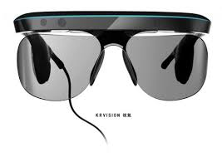
Digital Video Camera

Slide 8
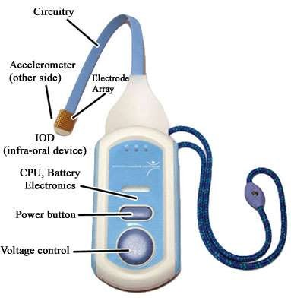
Brain Port Device

Slide 9
Simulation Circuitry
Programming device comprises of user interface and a processor
Converts digital inputs to electrical stimulations
Accelerometer
Provides head and body position information to the brain through electro-tactile stimulation of the tongue.

Slide 10
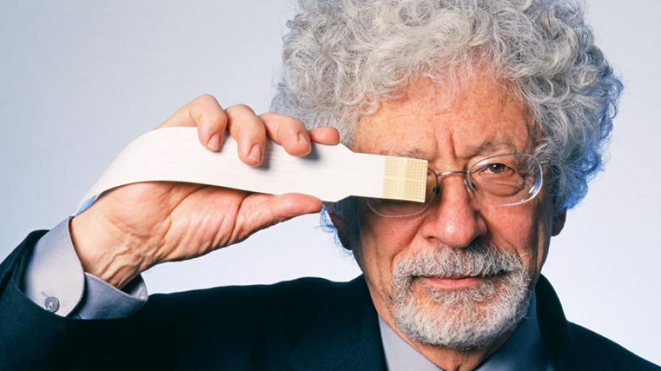
Electrode Array

Slide 11
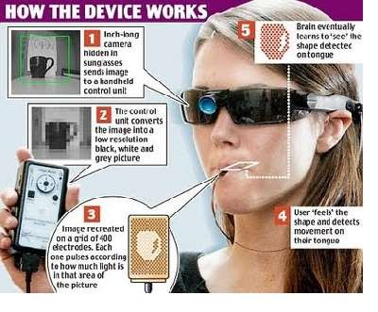
Working of Device

Slide 12
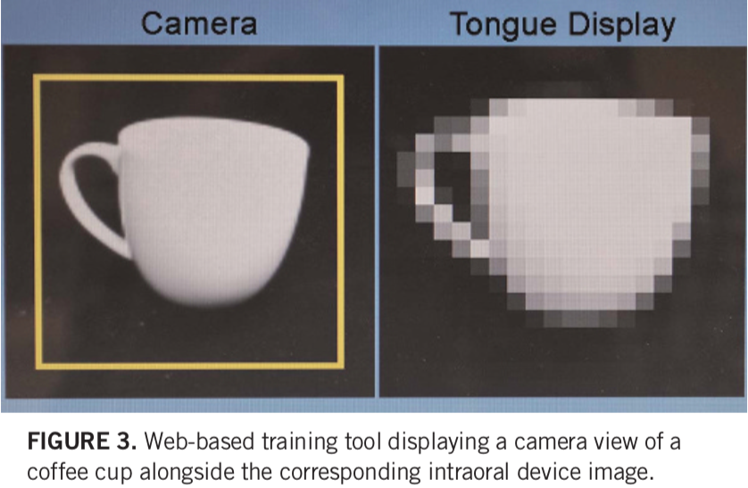

Slide 13

Advantages
Flexible usage
Independent operation
Rechargeable battery
Object recognition

Slide 14

Disadvantages
Can’t be adapted to work on senses that brain doesn’t already have.
Require training
High cost
Provides limited forms of sight only
Produce weak metallic taste sensations, a minor side effect.

Slide 15
Applications
Medical
Car Racing
Robotic Surgery
Military
Video gaming

Slide 16
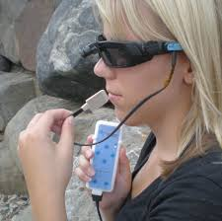
Conclusion
with this revolutionary Brain port System, we can hope that even blind people can feel the beauty and color of this world.

Slide 17

Any Queries?

